Slide 1


Working with Audio Editing tools
Done By
Arsath Noordeen A
Sudharsan A
Rahul V
Kannan S P
Absan
AUDACITY

Slide 2


Base Track
  Track: StayLoose – Go On Going
  Duration: 1:47 (trimmed)
  Short and clear for remix demonstration
  Song Link
3

Slide 3

Added Instrumental
  Track: Avicii – Wake Me Up
  Purpose: Add energy, rhythm, and contrast
  Style: EDM / Upbeat
  Matches tempo and complements the base track
  Song Link
3

Slide 4
Editing Techniques
  Bass & Treble adjustments: Improve tonal balance.
  Fade-in / Fade-out: Smooth track transitions.
  Crossfade: Seamless blending of tracks.
  Reverb / Echo effects: Add depth and spaciousness.
  Tempo alignment (Change Tempo): Synchronize beats between tracks.
  Other effects: Reverse small segments, low-pass filter for dynamic drops.
  Remix Creation: Layer base track with instrumental, adjust volumes, add effects → new remix version
  Finally save and export the edited audio file.
5

Slide 5
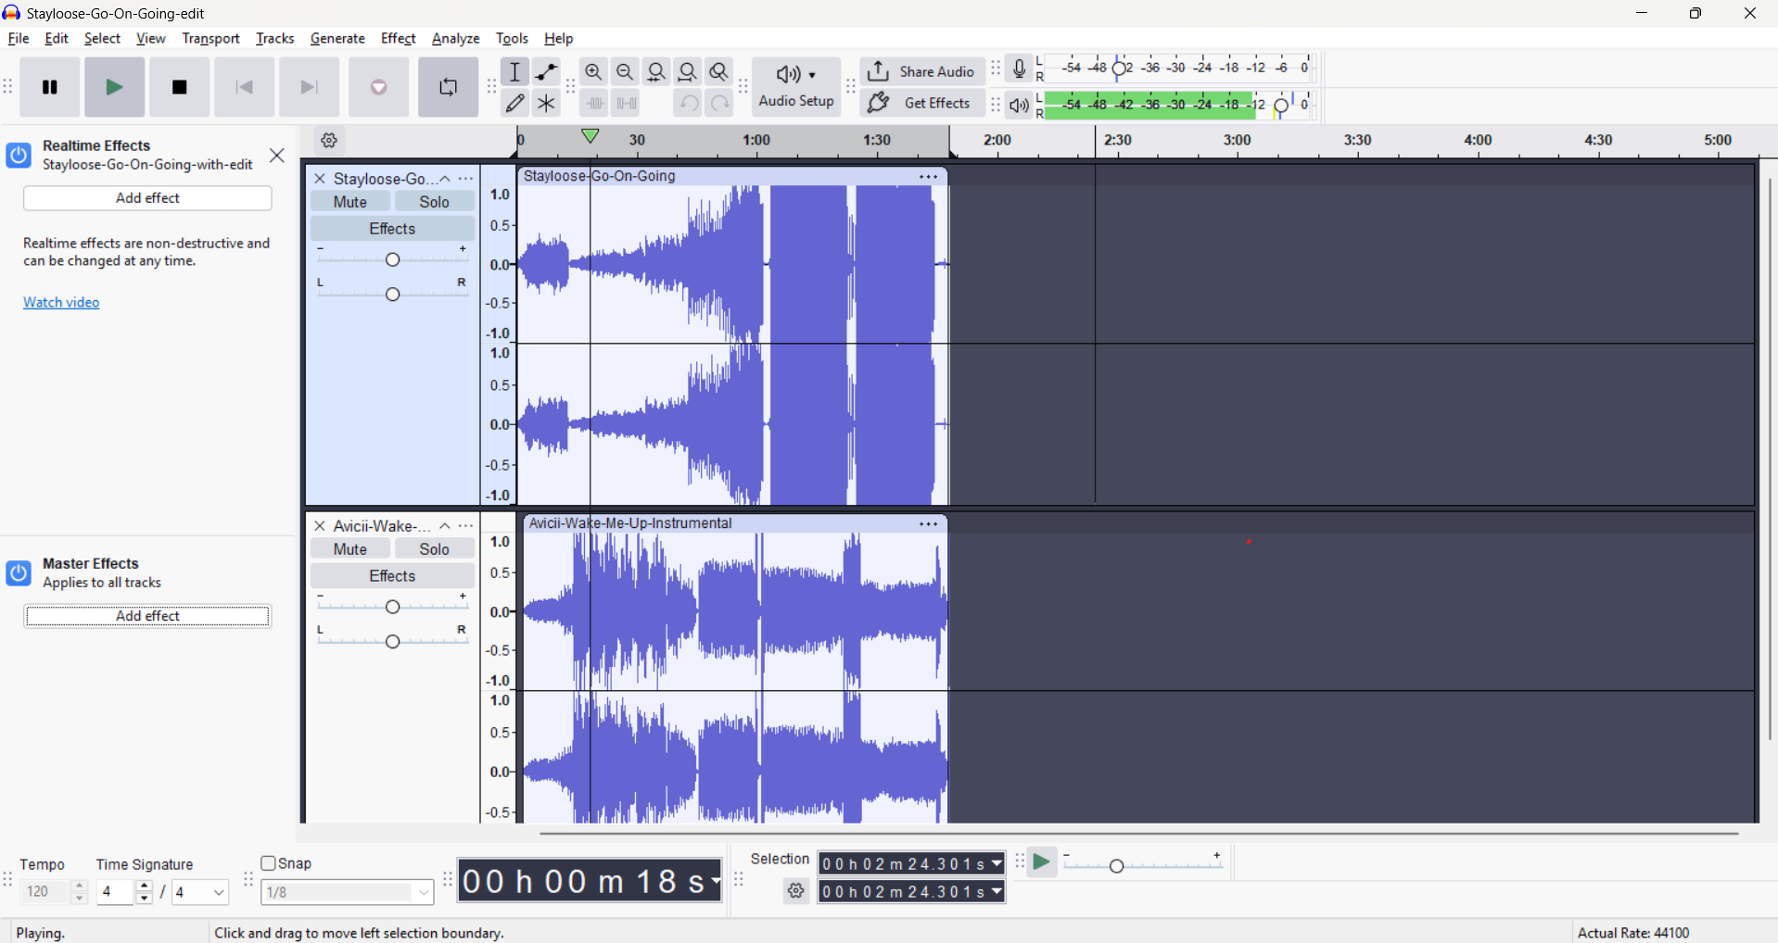
6
Overview

Slide 6
The End
THANK YOU FOR LISTENING

